Slide 1
Computer Architecture Experiment
Topic 1. Pipelined CPU supporting RISC-V
RV32I Instructions
浙江大学计算机学院

Slide 2
Outline
Experiment Purpose
Experiment Task
Basic Principle
Operating Procedures
Checkpoints

Slide 3
Experiment Purpose
Understand RISC-V RV32I instructions
Master the design methods of pipelined CPU executing RV32I instructions
Master the method of Pipeline Forwarding Detection and bypass unit design
Master the methods of 1-cycle stall of Predict-not-taken branch design
master methods of program verification of Pipelined CPU executing RV32I instructions

Slide 4
Experiment Task
Design of Pipelined CPU executing RV32I instructions.
Design datapath
Design Bypass Unit
Design CPU Controller
Verify the Pipelined CPU with program and observe the execution of program

Slide 5
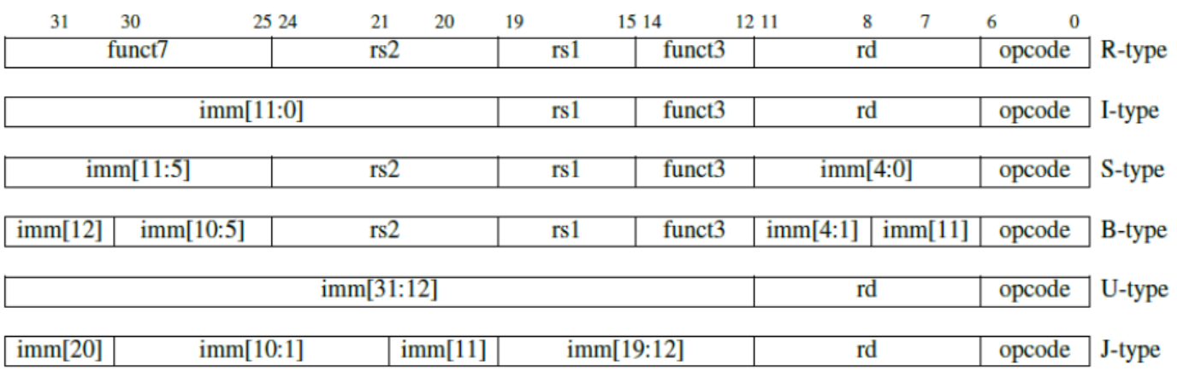
Pipelined CPU supporting execution of RV32I instructions

Slide 6
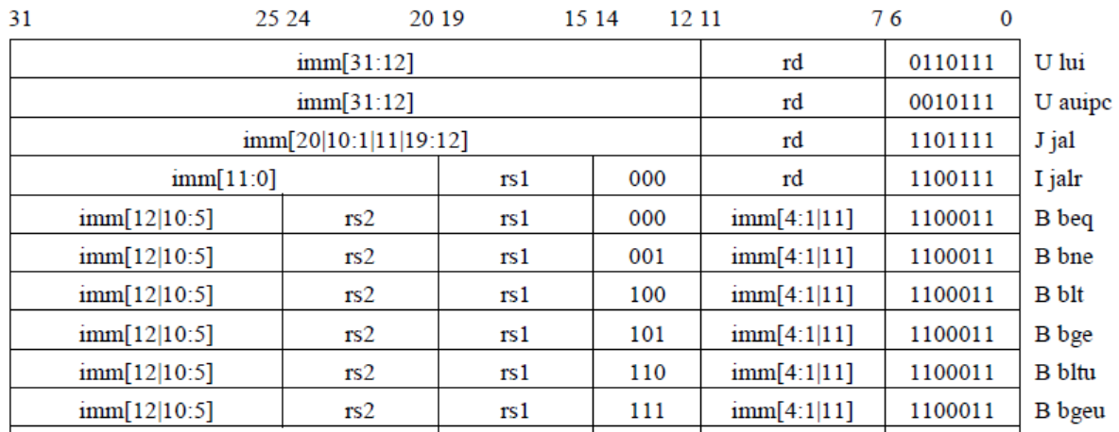
Pipelined CPU supporting execution of RV32I instructions

Slide 7
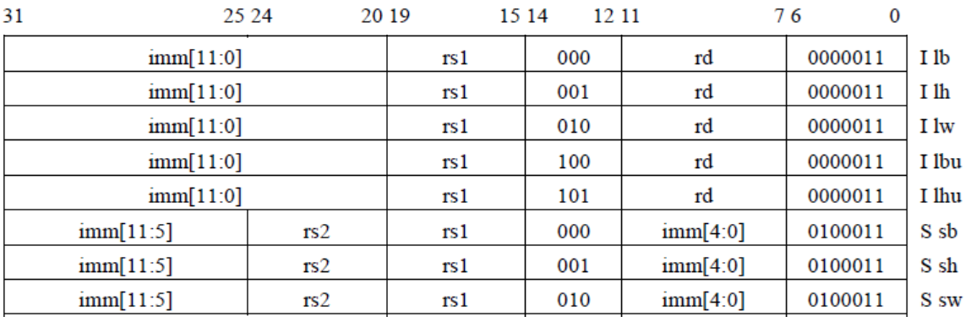
Pipelined CPU supporting execution of RV32I instructions

Slide 8
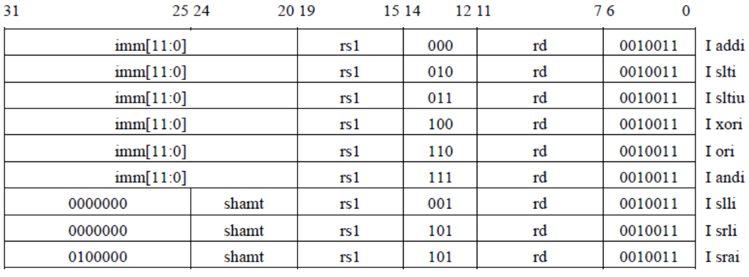
Pipelined CPU supporting execution of RV32I instructions

Slide 9
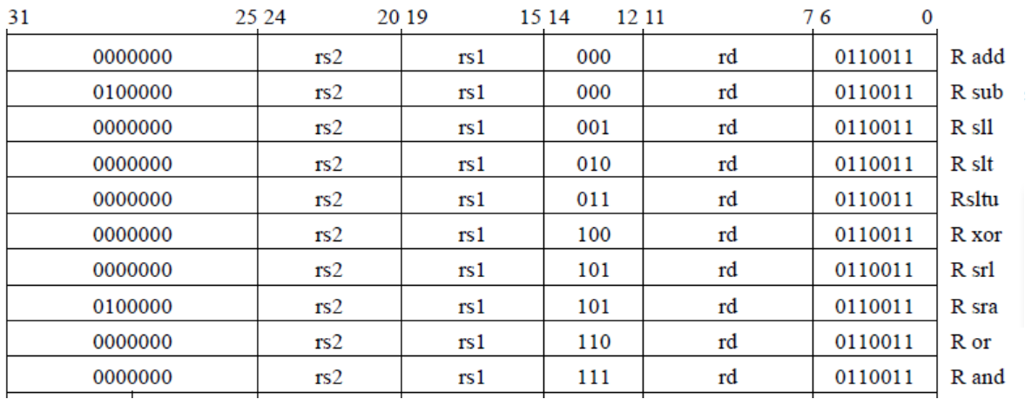
Pipelined CPU supporting execution of RV32I instructions

Slide 10
Instruction Demo

Slide 11
Data Hazard Causes Stalls

Slide 12
Pipeline Forward to Avoid the Data hazard

Slide 13
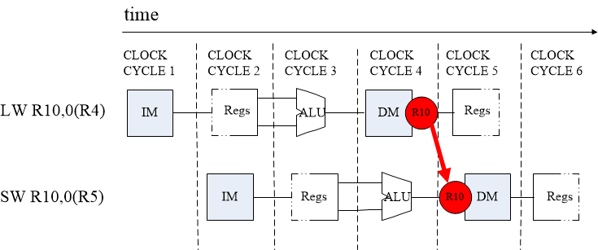
SW After LW

Slide 14
Condition in Which Bypass Unit doesn’t work

Slide 15
Pipeline Stalls

Slide 16
Instruction Demo

Slide 17
Execution result

Slide 18
Methods of resolving Control hazards
Freeze or flush the pipeline
Predict-not-taken
Predict-taken
Delayed branch

Slide 19
Freeze method

Slide 20
Predict-not-taken

Slide 21
Predict-taken method
60% of branch result is taken
Bring forward calculation of branch condition from MEM Stage to EX Stage, stall reduce from 3-cycle to 2-cycle.
Then bring forward from EX to ID, stall reduce from 2-cycle to 1-cycle.
1-cycle stall may be used for 1 delay slot

Slide 22
Stalls of Predict Methods for Control Hazard
Predict Methods | Status | Original Datapath | Address Calculation Forward | Condition Comparison Forward
Predict-taken | Hit (Need Branch) | 3 stall | 1 stall | 1 stall
Predict-taken | Miss (No Branch) | 3 stall | 3 stall | 1 stall
Predict-not-taken | Hit (No Branch) | go on | go on | go on
Predict-not-taken | Miss (Need Branch) | 3 stall | 3 stall | 1 stall

Slide 23
Pipelined CPU supporting RV32I instructions

Slide 24
Pipelined CPU supporting RV32I instructions

Slide 25
Pipelined CPU supporting RV32I instructions

Slide 26
Pipelined CPU supporting RV32I instructions

Slide 27
Instr. Mem.(1)
NO. | Instruction | Addr. | Label | ASM | Comment
0 | 00000013 | 0 | __start: | addi x0, x0, 0
1 | 00402103 | 4 |  | lw x2, 4(x0)
2 | 00802203 | 8 |  | lw x4, 8(x0)
3 | 004100b3 | C |  | add x1, x2, x4
4 | fff08093 | 10 |  | addi x1, x1, -1
5 | 00c02283 | 14 |  | lw x5, 12(x0)
6 | 01002303 | 18 |  | lw x6, 16(x0)
7 | 01402383 | 1C |  | lw x7, 20(x0)
8 | 402200b3 | 20 |  | sub x1,x4,x2
9 | 002270b3 | 24 |  | and x1,x4,x2
10 | 002260b3 | 28 |  | or x1,x4,x2
11 | 002240b3 | 2C |  | xor x1,x4,x2
12 | 002210b3 | 30 |  | sll x1,x4,x2
13 | 002220b3 | 34 |  | slt x1,x4,x2
14 | 004120b3 | 38 |  | slt x1,x2,x4

Slide 28
Instr. Mem.(2)
NO. | Instruction | Addr. | Label | ASM | Comment
15 | 002350b3 | 3C |  | srl x1, x6, x2
16 | 402350b3 | 40 |  | sra x1, x6, x2
17 | 4023d0b3 | 44 |  | sra x1, x7, x2
18 | 007330b3 | 48 |  | sltu x1, x6, x7
19 | 0063b0b3 | 4C |  | sltu x1, x7, x6
20 | 00000033 | 50 |  | add x0,x0,x0
21 | ffd50093 | 54 |  | addi x1,x10,-3
22 | 00f27093 | 58 |  | andi x1,x4,15
23 | 00f26093 | 5C |  | ori x1,x4,15
24 | 00f24093 | 60 |  | xori x1,x4,15
25 | 00f22093 | 64 |  | slti x1,x4,15
26 | 00121093 | 68 |  | slli x1,x4,1
27 | 00225093 | 6C |  | srli x1,x4,2
28 | 40c35093 | 70 |  | srai x1, x6, 12
29 | fff33093 | 74 |  | sltiu x1, x6, -1

Slide 29
Instr. Mem.(3)
NO. | Instruction | Addr. | Label | ASM | Comment
30 | fff3b093 | 78 |  | sltiu x1, x7, -1
31 | 00520863 | 7C |  | beq x4,x5,label0
32 | 00420663 | 80 |  | beq x4,x4,label0
33 | 00000013 | 84 |  | addi x0,x0,0
34 | 00000013 | 88 |  | addi x0,x0,0
35 | 00421863 | 8C | label0: | bne x4,x4,label1
36 | 00521663 | 90 |  | bne x4,x5,label1
37 | 00000013 | 94 |  | addi x0,x0,0
38 | 00000013 | 98 |  | addi x0,x0,0
39 | 0042c863 | 9C | label1: | blt x5,x4,label2
40 | 00524663 | A0 |  | blt x4,x5,label2
41 | 00000013 | A4 |  | addi x0,x0,0
42 | 00000013 | A8 |  | addi x0,x0,0
43 | 00736863 | AC | label2: | bltu x6,x7,label3
44 | 0063e663 | B0 |  | bltu x7,x6,label3

Slide 30
Instr. Mem.(4)
NO. | Instruction | Addr. | Label | ASM | Comment
45 | 00000013 | B4 |  | addi x0,x0,0
46 | 00000013 | B8 |  | addi x0,x0,0
47 | 00525863 | BC | label3: | bge x4,x5,label4
48 | 0042d663 | C0 |  | bge x5,x4,label4
49 | 00000013 | C4 |  | addi x0,x0,0
50 | 00000013 | C8 |  | addi x0,x0,0
51 | 0063f863 | CC | label4: | bgeu x7,x6,label5
52 | 00737663 | D0 |  | bgeu x6,x7,label5
53 | 00000013 | D4 |  | addi x0,x0,0
54 | 00000013 | D8 |  | addi x0,x0,0
55 | 00425663 | DC | label5: | bge x4,x4,label6
56 | 00000013 | E0 |  | addi x0,x0,0
57 | 00000013 | E4 |  | addi x0,x0,0
58 | 000040b7 | E8 | label6: | lui x1,4
59 | 00c000ef | EC |  | jal x1,12

Slide 31
Instr. Mem.(5)
NO. | Instruction | Addr. | Label | ASM | Comment
60 | 00000013 | F0 |  | addi x0,x0,0
61 | 00000013 | F4 |  | addi x0,x0,0
62 | 01802403 | F8 |  | lw x8, 24(x0)
63 | 00802e23 | FC |  | sw x8, 28(x0)
64 | 01c02083 | 100 |  | lw x1, 28(x0)
65 | 02801023 | 104 |  | sh x8, 32(x0)
66 | 02002083 | 108 |  | lw x1, 32(x0)
67 | 02800223 | 10C |  | sb x8, 36(x0)
68 | 02402083 | 110 |  | lw x1, 36(x0)
69 | 01a01083 | 114 |  | lh x1, 26(x0)
70 | 01a05083 | 118 |  | lhu x1, 26(x0)
71 | 01b00083 | 11C |  | lb x1, 27(x0)
72 | 01b04083 | 120 |  | lbu x1, 27(x0)
73 | ffff0097 | 124 |  | auipc x1, 0xffff0
74 | 000000e7 | 128 |  | jalr x1,0(x0)

Slide 32
Data Mem.
NO. | Data | Addr. | Comment
0 | 000080BF | 0
1 | 00000008 | 4
2 | 00000010 | 8
3 | 00000014 | C
4 | FFFF0000 | 10
5 | 0FFF0000 | 14
6 | FF000F0F | 18
7 | F0F0F0F0 | 1C
8 | 00000000 | 20
9 | 00000000 | 24
10 | 00000000 | 28
11 | 00000000 | 2C
12 | 00000000 | 30
13 | 00000000 | 34
14 | 00000000 | 38
15 | 00000000 | 3C
NO. | Instruction | Addr. | Comment
16 | 00000000 | 40
17 | 00000000 | 44
18 | 00000000 | 48
19 | 00000000 | 4C
20 | A3000000 | 50
21 | 27000000 | 54
22 | 79000000 | 58
23 | 15100000 | 5C
24 | 00000000 | 60
25 | 00000000 | 64
26 | 00000000 | 68
27 | 00000000 | 6C
28 | 00000000 | 70
29 | 00000000 | 74
30 | 00000000 | 78
31 | 00000000 | 7C

Slide 33
Test Bench
RV32core core(
.debug_en(1'b0),
.debug_step(1'b0),
.debug_addr(7'b0),
.debug_data(),
.clk(clk),
.rst(rst),
.interrupter(1'b0)
);
initial begin
clk = 0;
rst = 1;
#2 rst = 0;
end
always #1 clk = ~clk;

Slide 34
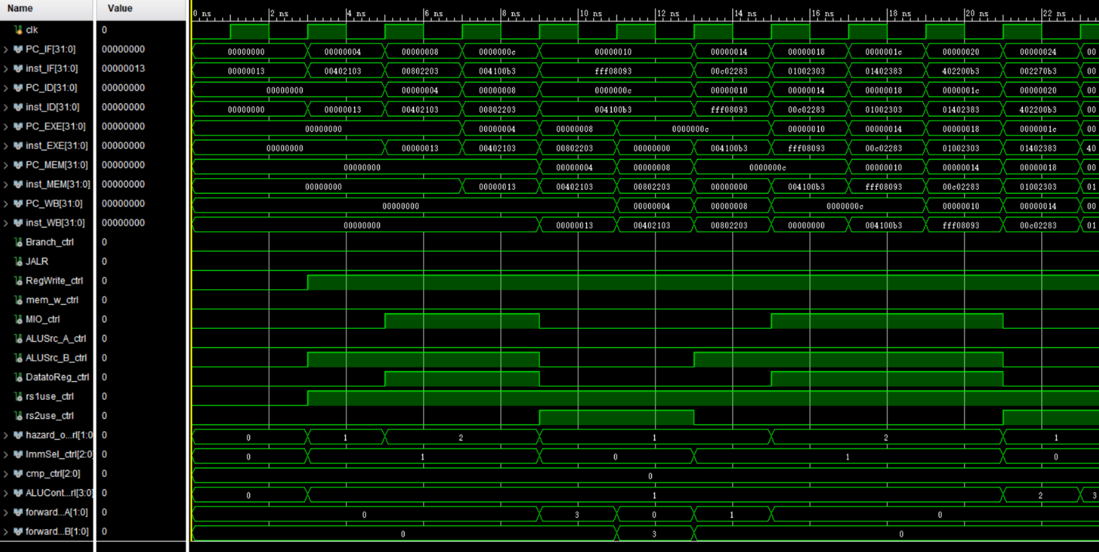
Simulation (1)

Slide 35
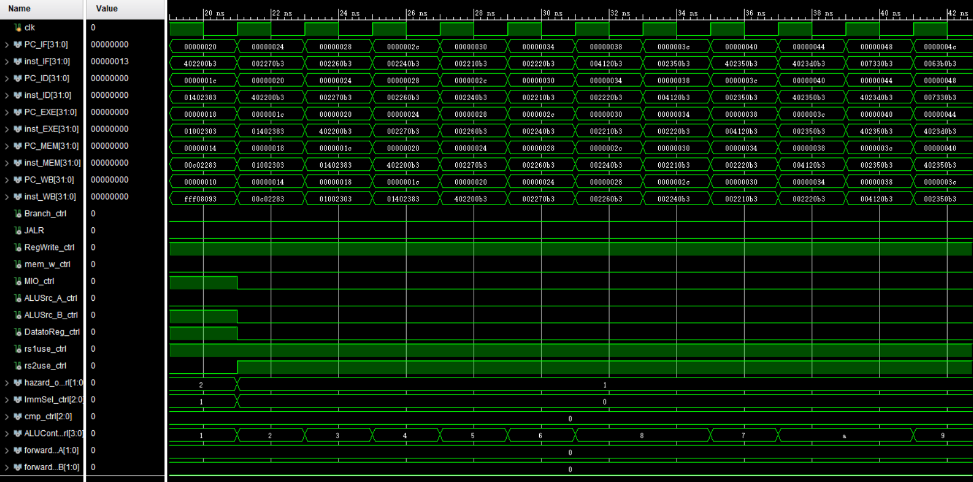
Simulation (2)

Slide 36
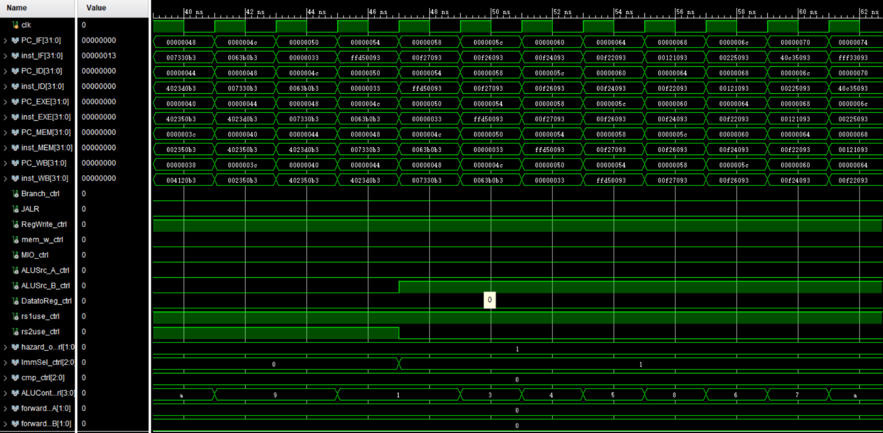
Simulation (3)

Slide 37
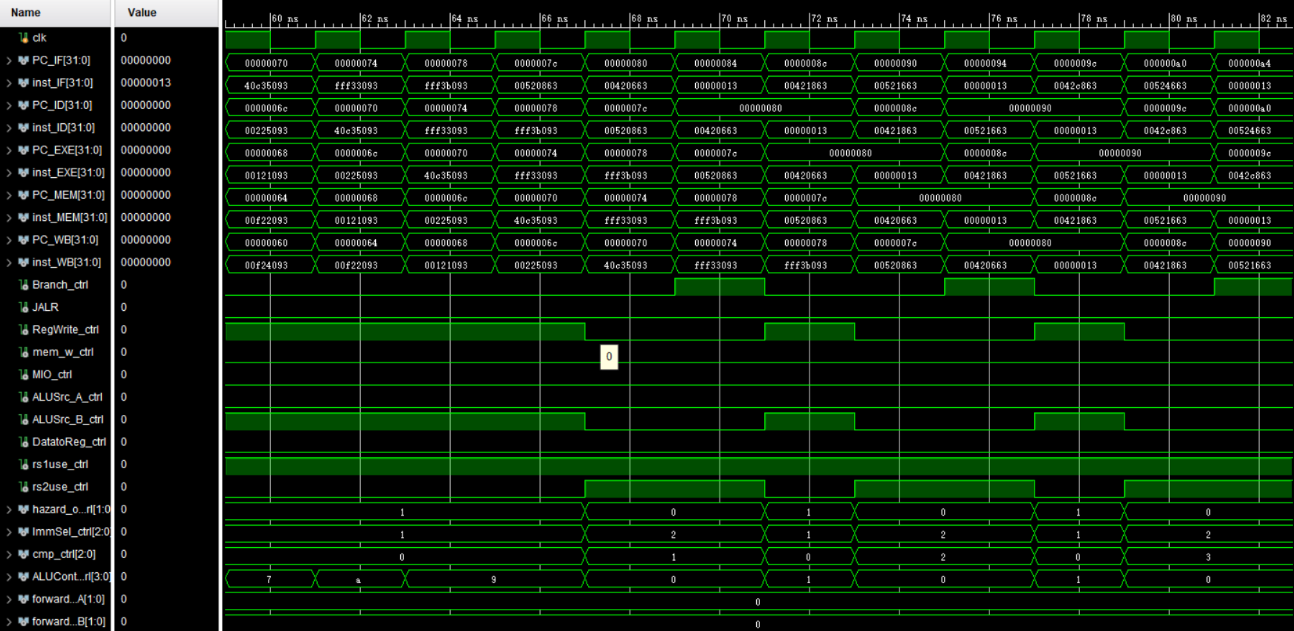
Simulation (4)

Slide 38
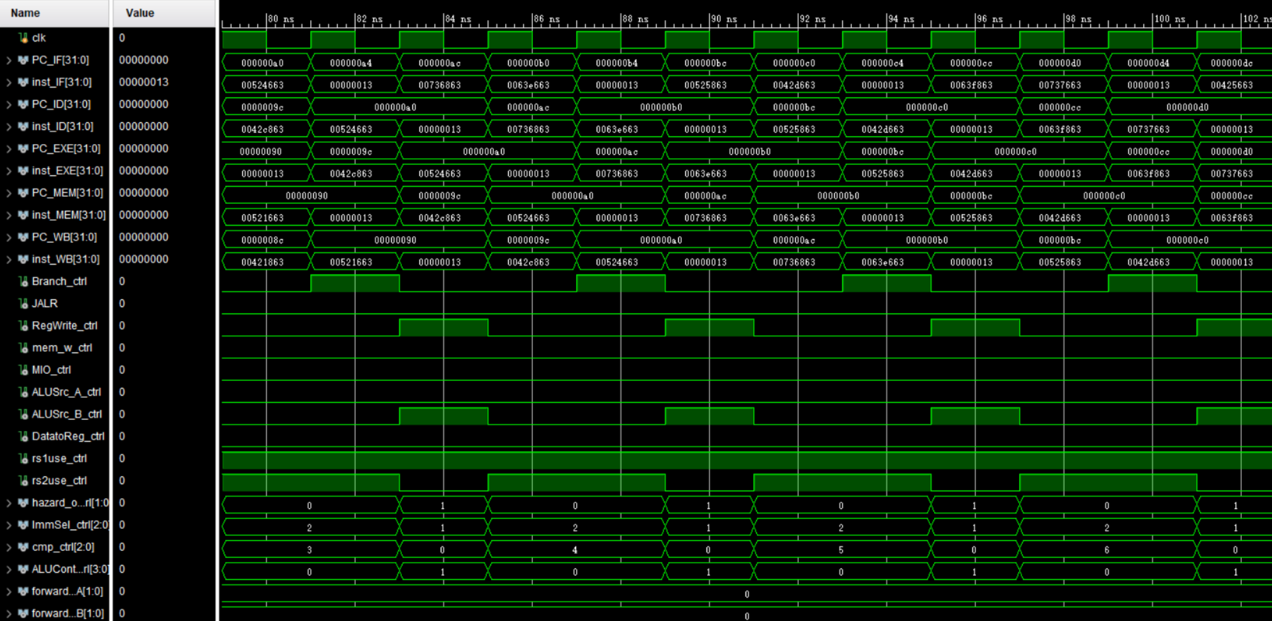
Simulation (5)

Slide 39
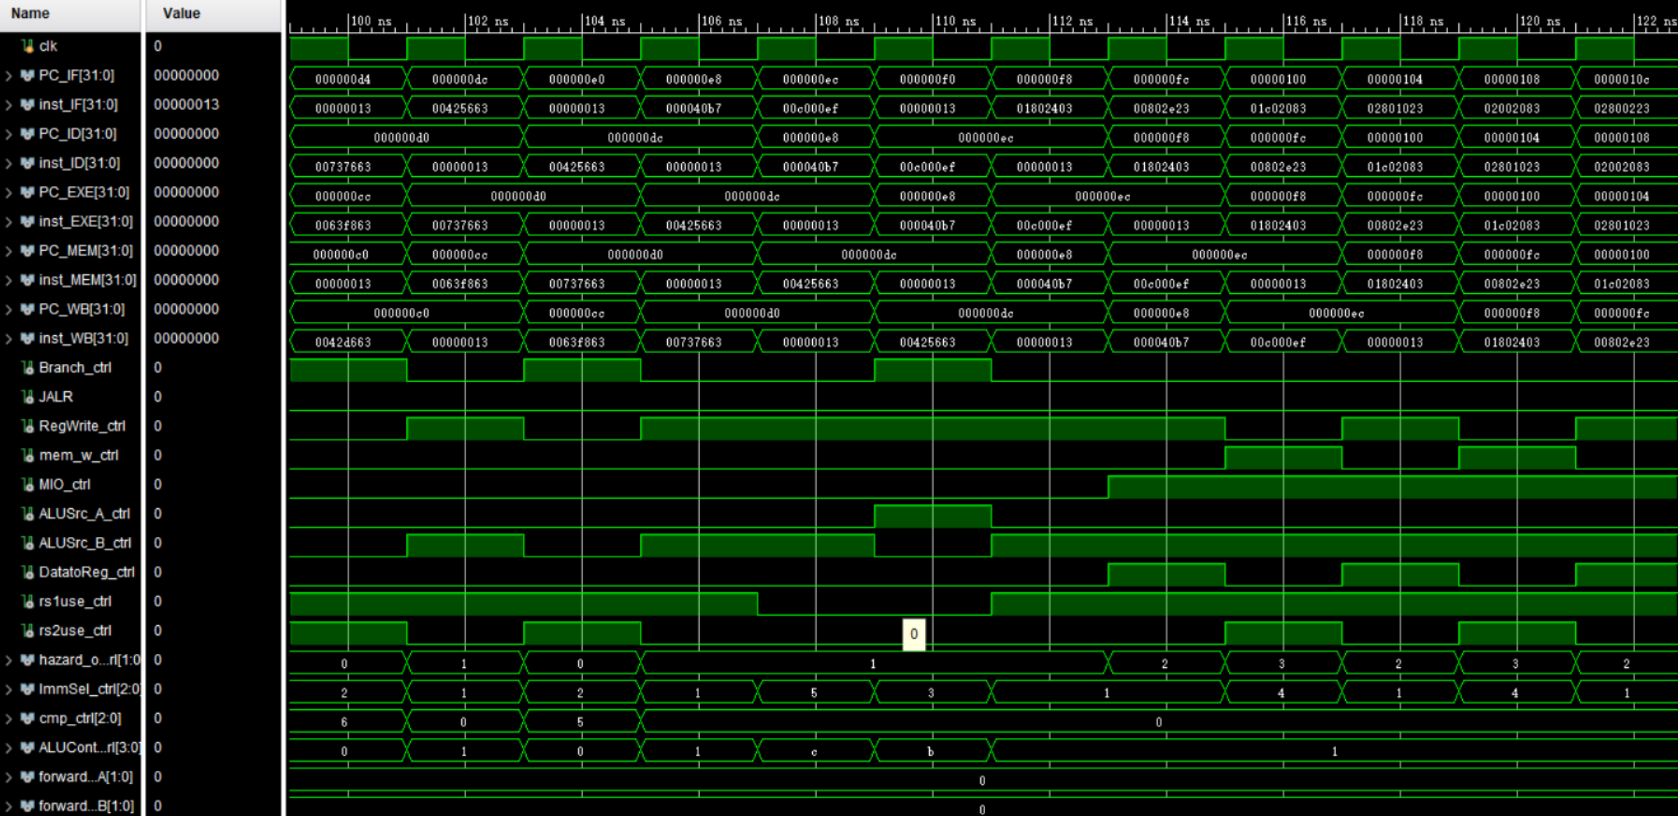
Simulation (6)

Slide 40
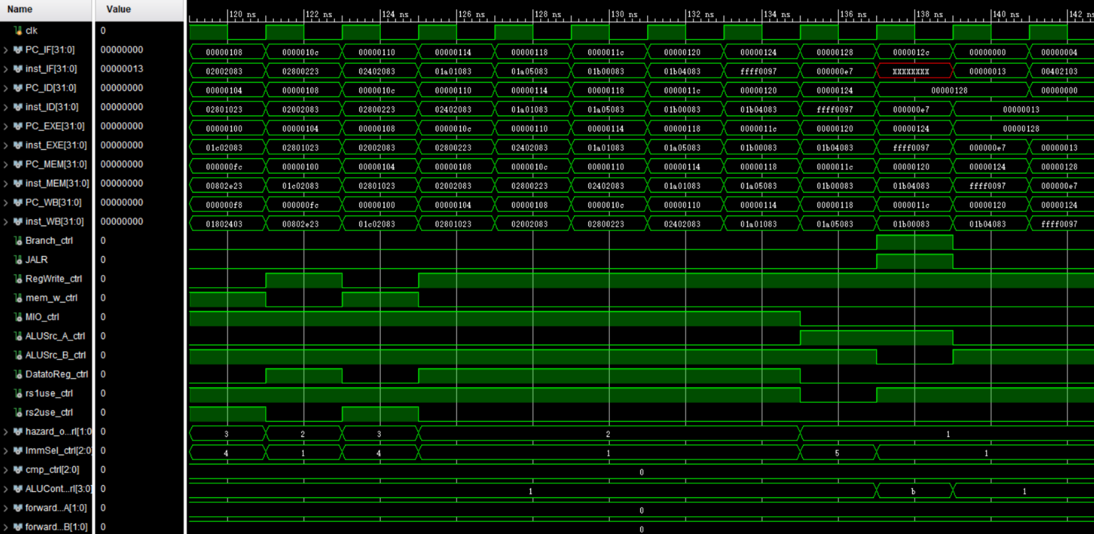
Simulation (7)

Slide 41
Checkpoints
CP 1:
Waveform Simulation of the Pipelined CPU with the verification program
CP 2:
FPGA Implementation of the Pipelined CPU with the verification program

Slide 42
Thanks!

